Slide 1
Fake News Detection
Team
Shanmukh Sri Surya Gopi
Shiva Kumar Midde
Srikar Morla
Kavya Prasanna Lakshmi Medikonda

Slide 2
Introduction
The spread of fake news undermines confidence and skews public conversation, making it a serious problem in the digital age.
To protect the integrity of information and fight false information, trustworthy detecting techniques are essential.
This research uses a Kaggle dataset to evaluate the effectiveness of multivariate data analysis in detecting fake news. We aim to offer insights into practical tactics for countering false information through factor analysis, regression models, and descriptive analysis.

Slide 3
Problem Statement
Our main goal is to determine how well multivariate data analysis works for identifying false news.
The Kaggle dataset is made up of textual and metadata pieces that are classified as true or fake news.
Assessing model performance, utilizing multivariate analysis methods, and analyzing dataset features are important goals.
Our objective is to offer valuable perspectives on efficacious tactics for identifying and countering the spread of fake data on the internet by means of meticulous examination.

Slide 4
Data Exploration
We lay the groundwork for our research by first looking at the composition and volume of our dataset.
A comprehensive assessment of news authenticity is facilitated by the dataset's essential components, which include title, text, subject, and date.
We developed a model and subsequent analytical approaches based on insights from descriptive statistics and data distribution, which revealed patterns and trends within the dataset.

Slide 5
Data Preparation
We took great care in preparing our data so that it would be appropriate for analysis.
To preserve the integrity of the data, we identified and eliminated duplicates.
To facilitate our study, we developed categorization labels that differentiate between authentic and fraudulent news.
To improve analytical readiness and guarantee consistency in our methodology, text normalization techniques were also used to standardize text format.

Slide 6
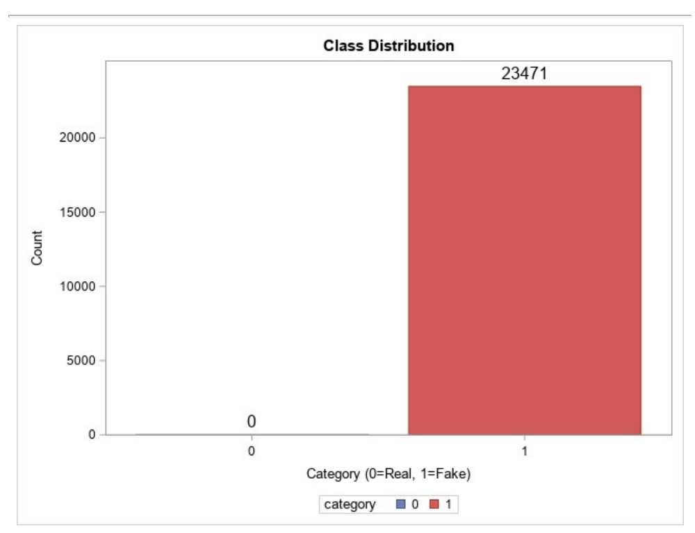
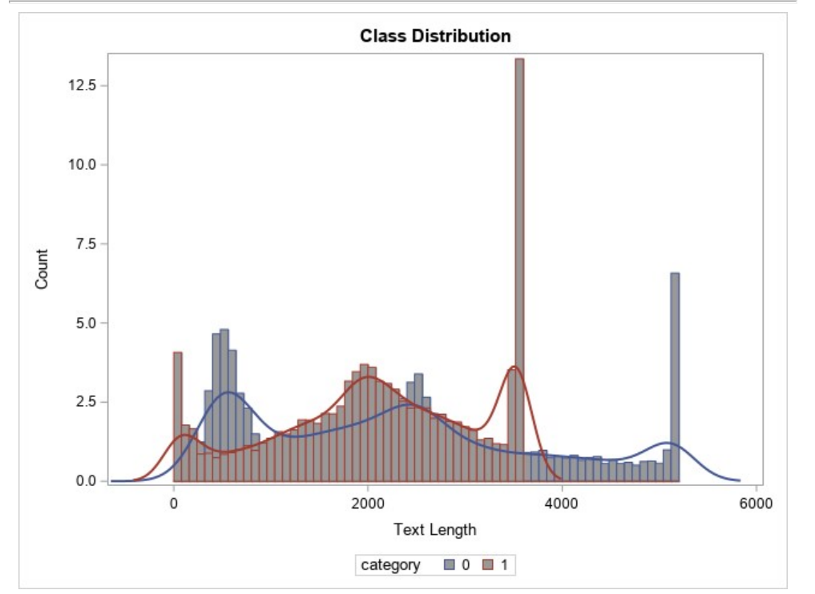
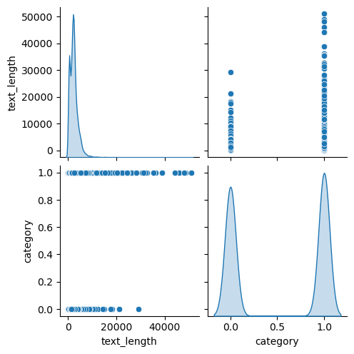
Data Visualization
Figure 1: Class Distribution
Figure 2: Distribution of Text Lengths
Figure 1: Class Distribution

Slide 7
Descriptive Statistics
An overview of the results of descriptive statistics :
Certified news (728 words), and fake news (632 words) is the average text lengths.
Distinct subjects: 3 false news, 5 certified news.
Analyzing non-null values helps to preserve data integrity.
Maintaining data integrity is essential to trustworthy analysis.
Assessing the legitimacy of news is made easier by descriptive statistics, which provide insights into the features of datasets. Reliability and accuracy in later analysis are improved by robust data integrity.

Slide 8
Factor Analysis
Hidden factors impacting news authenticity were revealed by the factor analysis methodology.
The degree and direction of the correlations between latent factors and observable variables are indicated by factor loadings, which are obtained through analysis.
Finding patterns and underlying structures in the data is aided by the interpretation of factor loadings.
Our detection algorithms are more effective when we can distinguish between real news and fraudulent information thanks to our increased understanding of these elements.

Slide 9
Regression Model
By analyzing the relationship between independent and dependent factors, multiple regression analysis predicts the legitimacy of news.
Subject, date, and text length are examples of independent variables.
Metrics for evaluating models, such as Mean Squared Error (MSE), evaluate how accurate a forecast is.
Our regression model's average squared difference (MSE) between predicted and actual values gives us information about how well the model is working. Its value is 3.341(Paik et al., 2020).

Slide 10
Additional Multivariate Technique
An alternate technique for classifying news is presented: logistic regression, which makes use of text data for forecasting.
On the test set, our logistic regression model earns an amazing accuracy score of 1.0, signifying flawless classification performance (Fleuren et al., 2020).
The impact of independent variables on the possibility that news items will be labeled as real or fake can be understood by interpreting the coefficients in logistic regression.

Slide 11
Conclusion and Recommendations
An overview of the main conclusions shows how well analytical methods can detect fake data.
Additional features should be investigated, and interdisciplinary cooperation should be encouraged.
The conclusion underscores the necessity of continual efforts and interdisciplinary teamwork to protect the integrity of information in the digital age and stresses the vital importance of battling fake news for the welfare of society.

Slide 12
References
Fleuren, L.M., Klausch, T.L., Zwager, C.L., Schoonmade, L.J., Guo, T., Roggeveen, L.F., Swart, E.L., Girbes, A.R., Thoral, P., Ercole, A. and Hoogendoorn, M., 2020. Machine learning for the prediction of sepsis: a systematic review and meta-analysis of diagnostic test accuracy. Intensive care medicine, 46, pp.383-400.https://link.springer.com/article/10.1007/s00134-019-05872-y
Paik, J.W., Lee, K.H. and Lee, J.H., 2020. Asymptotic performance analysis of maximum likelihood algorithm for direction-of-arrival estimation: Explicit expression of estimation error and mean square error. Applied Sciences, 10(7), p.2415. https://doi.org/10.3390/app10072415

Slide 13
THANKS!

